Slide 1

MODULE 2

Slide 2
Database Design
Conceptual design: (ER Model is used at this stage.)
  What are the entities and relationships in the enterprise?
  What information about these entities and relationships should we store in the database?
  What are the integrity constraints or business rules that hold?
  A database `schema’ in the ER Model can be represented pictorially (ER diagrams).
  Can map an ER diagram into a relational schema.
Slide No:L2-1
Notes:
2

Slide 3

Overview of Database Design Process
Slide 3- <number>

Slide 4
Modeling
A database can be modeled as:
  a collection of entities,
  relationship among entities.
An entity is an object that exists and is distinguishable from other objects.
  Example: specific person, company, event, plant
Entities have attributes
  Example: people have names and addresses
An entity set is a set of entities of the same type that share the same properties.
  Example: set of all persons, companies, trees, holidays

Slide 5
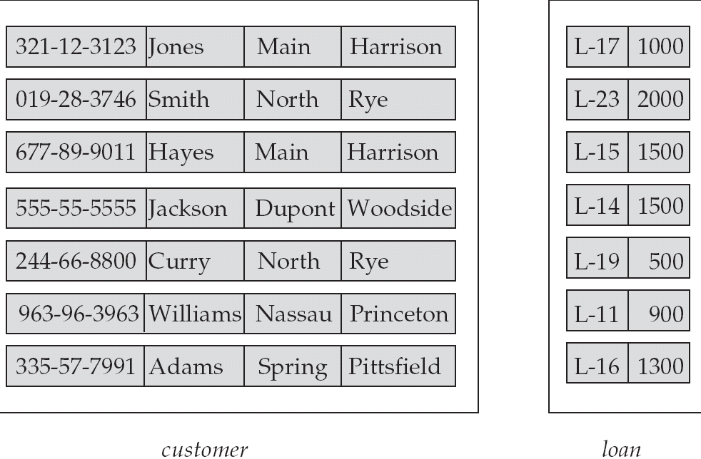
Entity Sets customer and loan
customer_id customer_ customer_ customer_ loan_ amount
name street city number
Slide No:L2-3

Slide 6
Example COMPANY Database
We need to create a database schema design based on the following (simplified) requirements of the COMPANY Database:
  The company is organized into DEPARTMENTs. Each department has a name, number and an employee who manages the department. We keep track of the start date of the department manager. A department may have several locations.
  Each department controls a number of PROJECTs. Each project has a unique name, unique number and is located at a single location.
Slide 3- <number>

Slide 7
Example COMPANY Database (Contd.)
  We store each EMPLOYEE’s social security number, address, salary, sex, and birthdate.
    Each employee works for one department but may work on several projects.
    We keep track of the number of hours per week that an employee currently works on each project.
    We also keep track of the direct supervisor of each employee.
  Each employee may have a number of DEPENDENTs.
    For each dependent, we keep track of their name, sex, birthdate, and relationship to the employee.
Slide 3- <number>

Slide 8
ER Model Concepts
Entities and Attributes
  Entities are specific objects or things in the mini-world that are represented in the database.
    For example the EMPLOYEE John Smith, the Research DEPARTMENT, the ProductX PROJECT
  Attributes are properties used to describe an entity.
    For example an EMPLOYEE entity may have the attributes Name, SSN, Address, Sex, BirthDate
  A specific entity will have a value for each of its attributes.
    For example a specific employee entity may have Name='John Smith', SSN='123456789', Address ='731, Fondren, Houston, TX', Sex='M', BirthDate='09-JAN-55‘
  Each attribute has a value set (or data type) associated with it – e.g. integer, string, subrange, enumerated type, …
Slide 3- <number>

Slide 9
Attributes
An entity is represented by a set of attributes, that is descriptive properties possessed by all members of an entity set.
Domain – the set of permitted values for each attribute
Attribute types:
  Simple and composite attributes.
  Single-valued and multi-valued attributes
    Example: multivalued attribute: phone_numbers
  Derived attributes
    Can be computed from other attributes
    Example: age, given date_of_birth
Example:
customer = (customer_id, customer_name, customer_street, customer_city )
loan = (loan_number, amount )
Slide No:L5-2

Slide 10
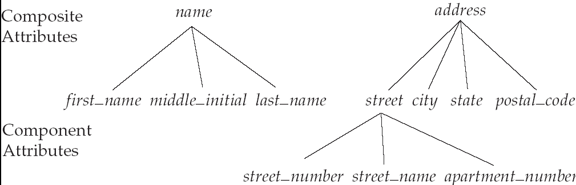
Composite Attributes
Slide No:L5-2

Slide 11
Types of Attributes (1)
Simple
  Each entity has a single atomic value for the attribute. For example, SSN or Sex.
Composite
  The attribute may be composed of several components. For example:
    Address(Apt#, House#, Street, City, State, ZipCode, Country), or
    Name(FirstName, MiddleName, LastName).
    Composition may form a hierarchy where some components are themselves composite.
Multi-valued
  An entity may have multiple values for that attribute. For example, Color of a CAR or PreviousDegrees of a STUDENT.
    Denoted as {Color} or {PreviousDegrees}.
Slide 3- <number>

Slide 12
Types of Attributes (2)
In general, composite and multi-valued attributes may be nested arbitrarily to any number of levels, although this is rare.
  For example, PreviousDegrees of a STUDENT is a composite multi-valued attribute denoted by {PreviousDegrees (College, Year, Degree, Field)}
  Multiple PreviousDegrees values can exist
  Each has four subcomponent attributes:
    College, Year, Degree, Field
Slide 3- <number>

Slide 13

Example of a composite attribute
Slide 3- <number>

Slide 14
Entity Types and Key Attributes (1)
Entities with the same basic attributes are grouped or typed into an entity type.
  For example, the entity type EMPLOYEE and PROJECT.
An attribute of an entity type for which each entity must have a unique value is called a key attribute of the entity type.
  For example, SSN of EMPLOYEE.
Slide 3- <number>

Slide 15
Entity Types and Key Attributes (2)
A key attribute may be composite.
  VehicleTagNumber is a key of the CAR entity type with components (Number, State).
An entity type may have more than one key.
  The CAR entity type may have two keys:
    VehicleIdentificationNumber (popularly called VIN)
    VehicleTagNumber (Number, State), aka license plate number.
Each key is underlined
Slide 3- <number>

Slide 16
Displaying an Entity type
In ER diagrams, an entity type is displayed in a rectangular box
Attributes are displayed in ovals
  Each attribute is connected to its entity type
  Components of a composite attribute are connected to the oval representing the composite attribute
  Each key attribute is underlined
  Multivalued attributes displayed in double ovals
See CAR example on next slide
Slide 3- <number>

Slide 17

Entity Type CAR with two keys and a corresponding Entity Set
Slide 3- <number>

Slide 18
Entity Set
Each entity type will have a collection of entities stored in the database
  Called the entity set
Previous slide shows three CAR entity instances in the entity set for CAR
Same name (CAR) used to refer to both the entity type and the entity set
Entity set is the current state of the entities of that type that are stored in the database
Slide 3- <number>

Slide 19
Initial Design of Entity Types for the COMPANY Database Schema
Based on the requirements, we can identify four initial entity types in the COMPANY database:
  DEPARTMENT
  PROJECT
  EMPLOYEE
  DEPENDENT
Their initial design is shown on the following slide
The initial attributes shown are derived from the requirements description
Slide 3- <number>

Slide 20

Initial Design of Entity Types:
EMPLOYEE, DEPARTMENT, PROJECT, DEPENDENT
Slide 3- <number>

Slide 21
Mapping Cardinality Constraints
Express the number of entities to which another entity can be associated via a relationship set.
Most useful in describing binary relationship sets.
For a binary relationship set the mapping cardinality must be one of the following types:
  One to one
  One to many
  Many to one
  Many to many
Slide No:L2-6

Slide 22
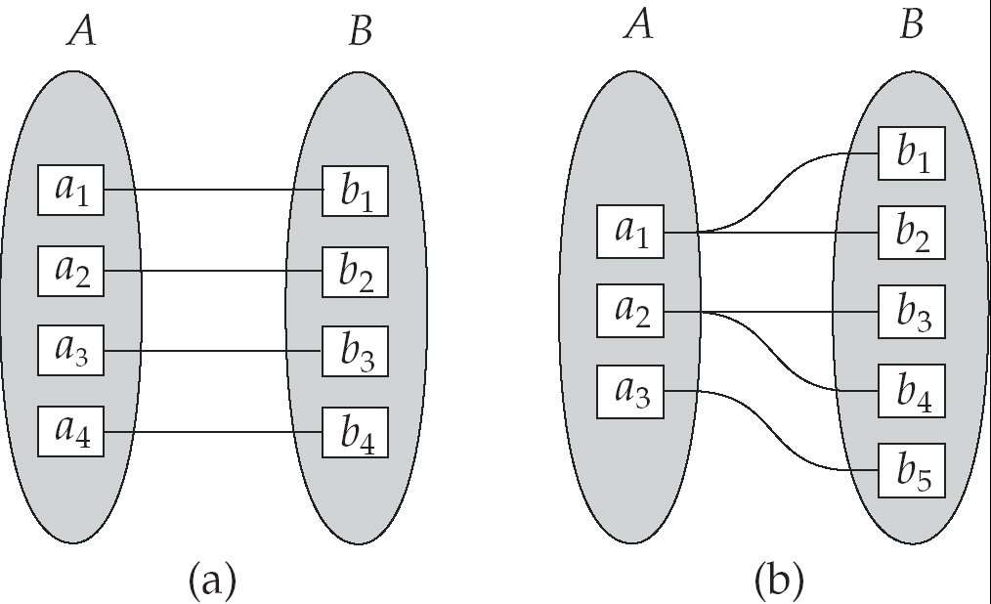
Mapping Cardinalities
One to one
One to many
Note: Some elements in A and B may not be mapped to any
elements in the other set
Slide No:L2-7

Slide 23
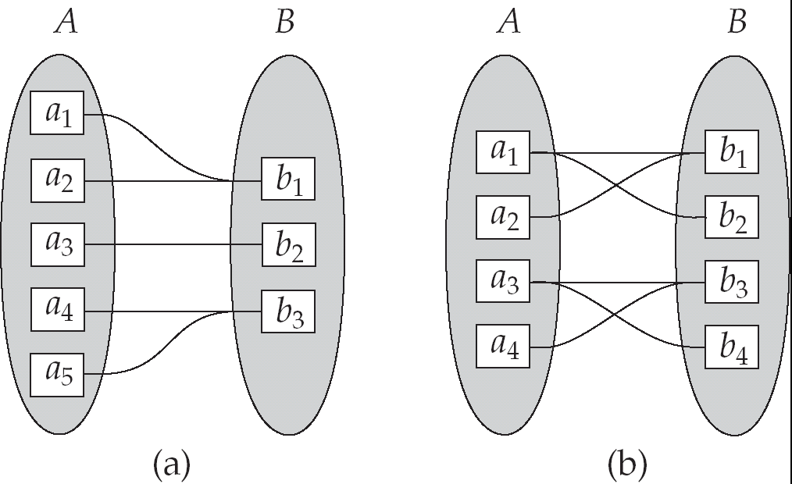
Mapping Cardinalities
Many to one
Many to many
Note: Some elements in A and B may not be mapped to any
elements in the other set
Slide No:L2-8

Slide 24
ER Model Basics
name
ssn
lot
Employees
Entity: Real-world object distinguishable from other objects. An entity is described (in DB) using a set of attributes.
Entity Set: A collection of similar entities. E.g., all employees.
  All entities in an entity set have the same set of attributes. (Until we consider ISA hierarchies, anyway!)
  Each entity set has a key.
  Each attribute has a domain.
Slide No:L2-9
Notes:
3
The slides for this text are organized into several modules. Each lecture contains about enough material for a 1.25 hour class period. (The time estimate is very approximate--it will vary with the instructor, and lectures also differ in length; so use this as a rough guideline.) This covers Lectures 1 and 2 (of 6) in Module (5).
Module (1): Introduction (DBMS, Relational Model)
Module (2): Storage and File Organizations (Disks, Buffering, Indexes)
Module (3): Database Concepts (Relational Queries, DDL/ICs, Views and Security)
Module (4): Relational Implementation (Query Evaluation, Optimization)
Module (5): Database Design (ER Model, Normalization, Physical Design, Tuning)
Module (6): Transaction Processing (Concurrency Control, Recovery)
Module (7): Advanced Topics

Slide 25
ER Model Basics (Contd.)
name
ssn
lot
since
name
dname
ssn
lot
did
budget
Employees
super-visor
subordinate
Employees
Works_In
Departments
Reports_To
Relationship: Association among two or more entities. E.g., Attishoo works in Pharmacy department.
Relationship Set: Collection of similar relationships.
  An n-ary relationship set R relates n entity sets E1 ... En; each relationship in R involves entities e1 E1, ..., en En
    Same entity set could participate in different relationship sets, or in different “roles” in same set.
Slide No:L2-10
Notes:
4

Slide 26
Relationship Sets
A relationship is an association among several entities
Example:
Hayes depositor A-102
customer entity relationship set account entity
A relationship set is a mathematical relation among n ≥ 2 entities, each taken from entity sets
{(e₁, e₂, … e_{n}) | e₁ ∈ E₁, e₂ ∈ E₂, …, e_{n} ∈ E_{n}}
where (e₁, e₂, …, e_{n}) is a relationship
  Example:
  (Hayes, A-102) ∈ depositor
Slide No:L3-1

Slide 27
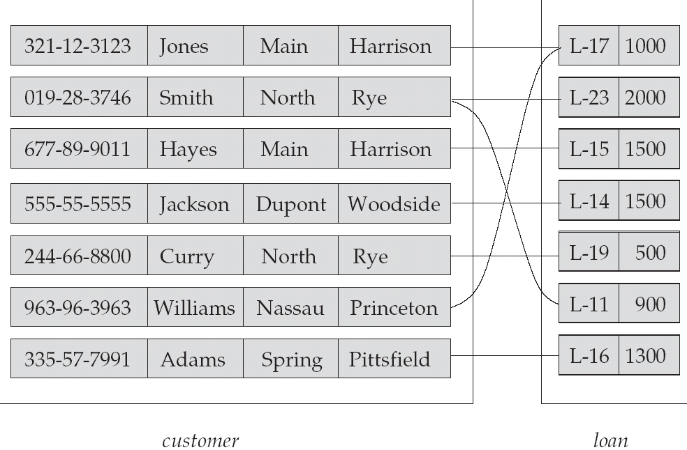
Relationship Set borrower
Slide No:L3-2

Slide 28
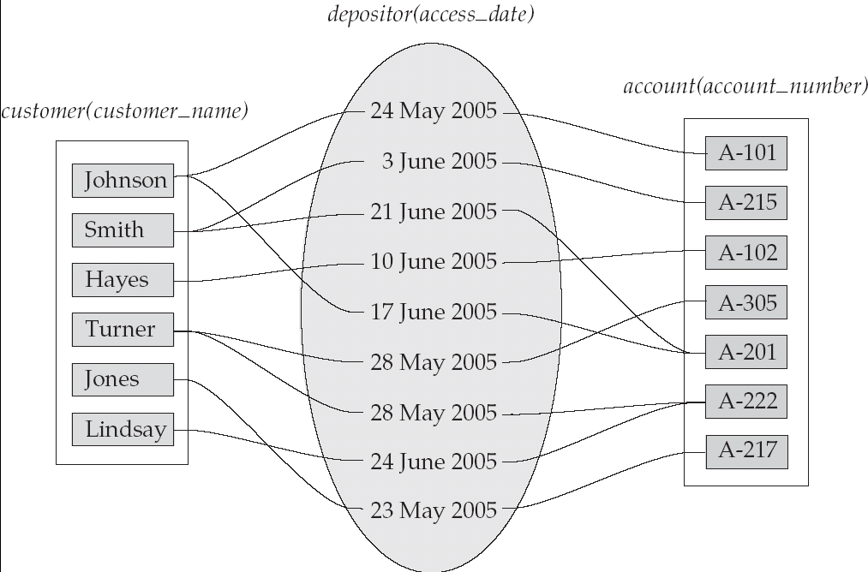
Relationship Sets (Cont.)
An attribute can also be property of a relationship set.
For instance, the depositor relationship set between entity sets customer and account may have the attribute access-date
Slide No:L3-3

Slide 29
Degree of a Relationship Set
Refers to number of entity sets that participate in a relationship set.
Relationship sets that involve two entity sets are binary (or degree two). Generally, most relationship sets in a database system are binary.
Relationship sets may involve more than two entity sets.
Slide No:L3-4

Slide 30
Degree of a Relationship Set
  Example: Suppose employees of a bank may have jobs (responsibilities) at multiple branches, with different jobs at different branches. Then there is a ternary relationship set between entity sets employee, job, and branch
Relationships between more than two entity sets are rare. Most relationships are binary. (More on this later.)
Slide No:L3-5

Slide 31
Key Constraints
Additional features of the ER model
since
name
dname
ssn
lot
did
budget
Employees
Manages
Departments
Consider Works_In: An employee can work in many departments; a dept can have many employees.
In contrast, each dept has at most one manager, according to the key constraint on Manages.
1-to-1
1-to Many
Many-to-1
Many-to-Many
Slide No:L4-1
Notes:
6

Slide 32
Participation Constraints
Does every department have a manager?
  If so, this is a participation constraint: the participation of Departments in Manages is said to be total (vs. partial).
    Every Departments entity must appear in an instance of the Manages relationship.
since
since
name
name
dname
dname
ssn
did
did
budget
lot
budget
Employees
Manages
Departments
Works_In
since
Slide No:L4-2
Notes:
8

Slide 33
Weak Entities
A weak entity can be identified uniquely only by considering the primary key of another (owner) entity.
  Owner entity set and weak entity set must participate in a one-to-many relationship set (one owner, many weak entities).
  Weak entity set must have total participation in this identifying relationship set.
name
ssn
lot
cost
pname
age
Employees
Policy
Dependents
Slide No:L4-3
Notes:
10

Slide 34
Weak Entity Sets
An entity set that does not have a primary key is referred to as a weak entity set.
The existence of a weak entity set depends on the existence of a identifying entity set
  it must relate to the identifying entity set via a total, one-to-many relationship set from the identifying to the weak entity set
  Identifying relationship depicted using a double diamond
The discriminator (or partial key) of a weak entity set is the set of attributes that distinguishes among all the entities of a weak entity set.
The primary key of a weak entity set is formed by the primary key of the strong entity set on which the weak entity set is existence dependent, plus the weak entity set’s discriminator.
Slide No:L4-4

Slide 35
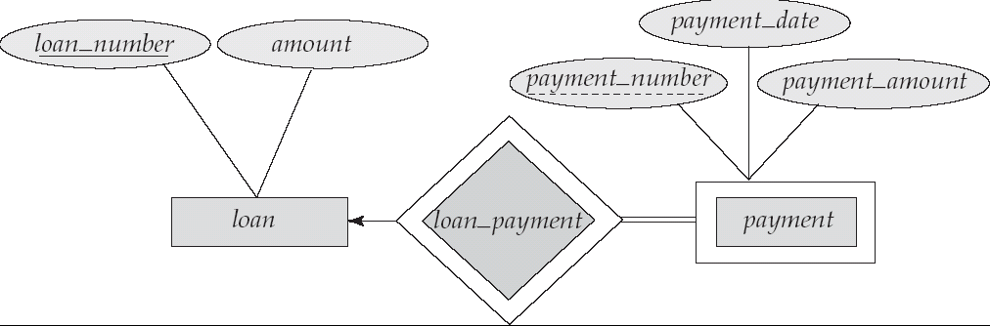
Weak Entity Sets (Cont.)
We depict a weak entity set by double rectangles.
We underline the discriminator of a weak entity set with a dashed line.
payment_number – discriminator of the payment entity set
Primary key for payment – (loan_number, payment_number)
Slide No:L4-5

Slide 36
Weak Entity Sets (Cont.)
Note: the primary key of the strong entity set is not explicitly stored with the weak entity set, since it is implicit in the identifying relationship.
If loan_number were explicitly stored, payment could be made a strong entity, but then the relationship between payment and loan would be duplicated by an implicit relationship defined by the attribute loan_number common to payment and loan
Slide No:L4-6

Slide 37
More Weak Entity Set Examples
In a university, a course is a strong entity and a course_offering can be modeled as a weak entity
The discriminator of course_offering would be semester (including year) and section_number (if there is more than one section)
If we model course_offering as a strong entity we would model course_number as an attribute.
Then the relationship with course would be implicit in the course_number attribute
Slide No:L4-7

Slide 38
ISA (`is a’) Hierarchies
name
As in C++, or other PLs, attributes are inherited.
If we declare A ISA B,
every A entity is also
considered to be a B
entity.
ssn
lot
Employees
hourly_wages
hours_worked
ISA
contractid
Contract_Emps
Hourly_Emps
Overlap constraints: Can Joe be an Hourly_Emps as well as a Contract_Emps entity? (Allowed/disallowed)
Covering constraints: Does every Employees entity also have to be an Hourly_Emps or a Contract_Emps entity? (Yes/no)
Reasons for using ISA:
  To add descriptive attributes specific to a subclass.
  To identify entitities that participate in a relationship.
Slide No:L5-1
Notes:
12

Slide 39
Aggregation
Used when we have to model a relationship involving (entitity sets and) a relationship set.
  Aggregation allows us to treat a relationship set as an entity set for purposes of participation in (other) relationships.
name
ssn
lot
Employees
Monitors
until
started_on
since
dname
pid
pbudget
did
budget
Projects
Sponsors
Departments
Aggregation vs. ternary relationship:
Monitors is a distinct relationship, with a descriptive attribute.
Also, can say that each sponsorship is monitored by at most one employee.
Slide No:L5-2
Notes:
2

Slide 40
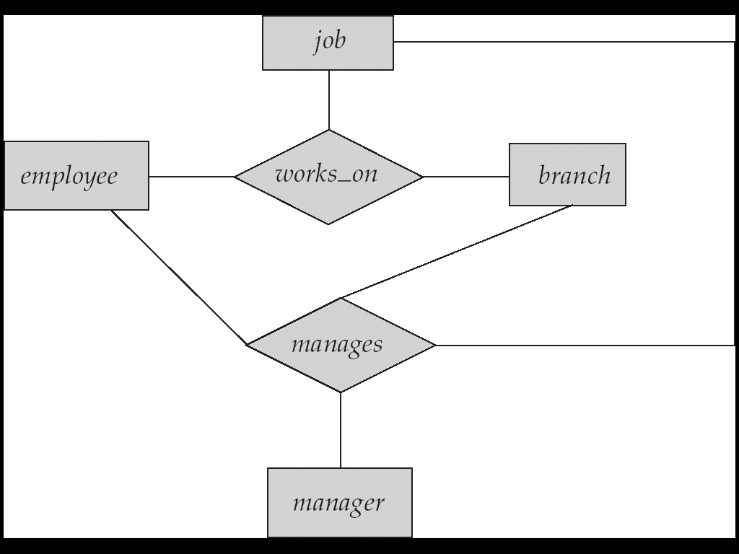
Aggregation
Consider the ternary relationship works_on, which we saw earlier
Suppose we want to record managers for tasks performed by an employee at a branch
Slide No:L5-3

Slide 41
Aggregation (Cont.)
Relationship sets works_on and manages represent overlapping information
  Every manages relationship corresponds to a works_on relationship
  However, some works_on relationships may not correspond to any manages relationships
    So we can’t discard the works_on relationship
Eliminate this redundancy via aggregation
  Treat relationship as an abstract entity
  Allows relationships between relationships
  Abstraction of relationship into new entity
Slide No:L5-4

Slide 42
Aggregation (Cont.)
Eliminate this redundancy via aggregation
  Treat relationship as an abstract entity
  Allows relationships between relationships
  Abstraction of relationship into new entity
Without introducing redundancy, the following diagram represents:
  An employee works on a particular job at a particular branch
  An employee, branch, job combination may have an associated manager
Slide No:L5-5

Slide 43
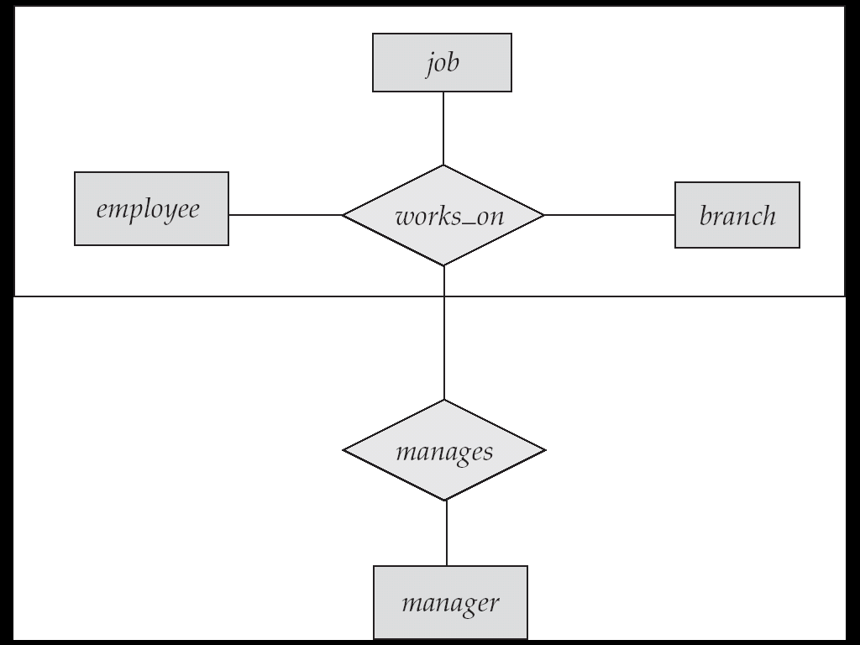
E-R Diagram With Aggregation
Slide No:L5-6

Slide 44
Conceptual Design Using the ER Model
Design choices:
  Should a concept be modeled as an entity or an attribute?
  Should a concept be modeled as an entity or a relationship?
  Identifying relationships: Binary or ternary? Aggregation?
Constraints in the ER Model:
  A lot of data semantics can (and should) be captured.
  But some constraints cannot be captured in ER diagrams.
Slide No:L6-1
Notes:
3

Slide 45
Entity vs. Attribute
Should address be an attribute of Employees or an entity (connected to Employees by a relationship)?
Depends upon the use we want to make of address information, and the semantics of the data:
    If we have several addresses per employee, address must be an entity (since attributes cannot be set-valued).
    If the structure (city, street, etc.) is important, e.g., we want to retrieve employees in a given city, address must be modeled as an entity (since attribute values are atomic).
Slide No:L6-2

Slide 46
Entity vs. Attribute (Contd.)
Works_In4 does not allow an employee to work in a department for two or more periods.
Similar to the problem of wanting to record several addresses for an employee: We want to record several values of the descriptive attributes for each instance of this relationship. Accomplished by introducing new entity set, Duration.
from
to
name
dname
ssn
lot
did
budget
Employees
Works_In4
Departments
name
dname
ssn
lot
did
budget
Employees
Works_In4
Departments
from
Duration
to
Slide No:L6-3
Notes:
5

Slide 47
Entity vs. Relationship
First ER diagram OK if a manager gets a separate discretionary budget for each dept.
What if a manager gets a discretionary budget that covers all managed depts?
  Redundancy: dbudget stored for each dept managed by manager.
  Misleading: Suggests dbudget associated with department-mgr combination.
since
dbudget
name
dname
ssn
lot
did
budget
Employees
Manages2
Departments
name
ssn
lot
since
dname
Employees
did
budget
Manages2
Departments
ISA
This fixes the
problem!
Managers
dbudget
Slide No:L6-4
Notes:
6

Slide 48
Binary vs. Ternary Relationships
If each policy is owned by just 1 employee, and each dependent is tied to the covering policy, first diagram is inaccurate.
What are the additional constraints in the 2nd diagram?
name
ssn
lot
pname
age
Employees
Covers
Dependents
Bad design
Policies
policyid
cost
name
pname
age
ssn
lot
Dependents
Employees
Purchaser
Beneficiary
Better design
Policies
Slide No:L6-5
policyid
cost
Notes:
7

Slide 49
Binary vs. Ternary Relationships (Contd.)
Previous example illustrated a case when two binary relationships were better than one ternary relationship.
An example in the other direction: a ternary relation Contracts relates entity sets Parts, Departments and Suppliers, and has descriptive attribute qty. No combination of binary relationships is an adequate substitute:
  S “can-supply” P, D “needs” P, and D “deals-with” S does not imply that D has agreed to buy P from S.
  How do we record qty?
Slide No:L6-6
Notes:
9

Slide 50
Logical DB Design: ER to Relational
Entity sets to tables:
CREATE TABLE Employees
(ssn CHAR(11),
name CHAR(20),
lot INTEGER,
PRIMARY KEY (ssn))
name
ssn
lot
Employees
Slide No:L3-1
Notes:
3
The slides for this text are organized into several modules. Each lecture contains about enough material for a 1.25 hour class period. (The time estimate is very approximate--it will vary with the instructor, and lectures also differ in length; so use this as a rough guideline.) This covers Lectures 1 and 2 (of 6) in Module (5).
Module (1): Introduction (DBMS, Relational Model)
Module (2): Storage and File Organizations (Disks, Buffering, Indexes)
Module (3): Database Concepts (Relational Queries, DDL/ICs, Views and Security)
Module (4): Relational Implementation (Query Evaluation, Optimization)
Module (5): Database Design (ER Model, Normalization, Physical Design, Tuning)
Module (6): Transaction Processing (Concurrency Control, Recovery)
Module (7): Advanced Topics

Slide 51
Relationship Sets to Tables
In translating a relationship set to a relation, attributes of the relation must include:
  Keys for each participating entity set (as foreign keys).
    This set of attributes forms a superkey for the relation.
  All descriptive attributes.
CREATE TABLE Works_In(
ssn CHAR(11),
did INTEGER,
since DATE,
PRIMARY KEY (ssn, did),
FOREIGN KEY (ssn)
REFERENCES Employees,
FOREIGN KEY (did)
REFERENCES Departments)
Slide No:L3-2
Notes:
5

Slide 52
Review: Key Constraints
Each dept has at most one manager, according to the key constraint on Manages.
since
name
dname
ssn
lot
did
budget
Employees
Manages
Departments
Translation to
relational model?
1-to-1
1-to Many
Many-to-1
Many-to-Many
Slide No:L3-3
Notes:
6

Slide 53
Translating ER Diagrams with Key Constraints
Map relationship to a table:
  Note that did is the key now!
  Separate tables for Employees and Departments.
Since each department has a unique manager, we could instead combine Manages and Departments.
CREATE TABLE Manages(
ssn CHAR(11),
did INTEGER,
since DATE,
PRIMARY KEY (did),
FOREIGN KEY (ssn) REFERENCES Employees,
FOREIGN KEY (did) REFERENCES Departments)
CREATE TABLE Dept_Mgr(
did INTEGER,
dname CHAR(20),
budget REAL,
ssn CHAR(11),
since DATE,
PRIMARY KEY (did),
FOREIGN KEY (ssn) REFERENCES Employees)
Slide No:L3-4
Notes:
7

Slide 54
Review: Participation Constraints
Does every department have a manager?
  If so, this is a participation constraint: the participation of Departments in Manages is said to be total (vs. partial).
    Every did value in Departments table must appear in a row of the Manages table (with a non-null ssn value!)
since
since
name
name
dname
dname
ssn
did
did
budget
lot
budget
Employees
Manages
Departments
Works_In
since
Slide No:L3-5
Notes:
8

Slide 55
Participation Constraints in SQL
We can capture participation constraints involving one entity set in a binary relationship, but little else (without resorting to CHECK constraints).
CREATE TABLE Dept_Mgr(
did INTEGER,
dname CHAR(20),
budget REAL,
ssn CHAR(11) NOT NULL,
since DATE,
PRIMARY KEY (did),
FOREIGN KEY (ssn) REFERENCES Employees,
ON DELETE NO ACTION)
Slide No:L3-6
Notes:
9

Slide 56
Review: Weak Entities
A weak entity can be identified uniquely only by considering the primary key of another (owner) entity.
  Owner entity set and weak entity set must participate in a one-to-many relationship set (1 owner, many weak entities).
  Weak entity set must have total participation in this identifying relationship set.
name
ssn
lot
cost
pname
age
Employees
Policy
Dependents
Slide No:L4-1
Notes:
10

Slide 57
Translating Weak Entity Sets
Weak entity set and identifying relationship set are translated into a single table.
  When the owner entity is deleted, all owned weak entities must also be deleted.
CREATE TABLE Dep_Policy (
pname CHAR(20),
age INTEGER,
cost REAL,
ssn CHAR(11) NOT NULL,
PRIMARY KEY (pname, ssn),
FOREIGN KEY (ssn) REFERENCES Employees,
ON DELETE CASCADE)
Slide No:L4-2
Notes:
11

Slide 58
Review: ISA Hierarchies
As in C++, or other PLs, attributes are inherited.
If we declare A ISA B, every A entity is also considered to be a B entity.
name
ssn
lot
Employees
hourly_wages
hours_worked
ISA
contractid
Hourly_Emps
Contract_Emps
Overlap constraints: Can Joe be an Hourly_Emps as well as a Contract_Emps entity? (Allowed/disallowed)
Covering constraints: Does every Employees entity also have to be an Hourly_Emps or a Contract_Emps entity? (Yes/no)
Slide No:L4-3
Notes:
12

Slide 59
Translating ISA Hierarchies to Relations
General approach:
  3 relations: Employees, Hourly_Emps and Contract_Emps.
    Hourly_Emps: Every employee is recorded in Employees. For hourly emps, extra info recorded in Hourly_Emps (hourly_wages, hours_worked, ssn); must delete Hourly_Emps tuple if referenced Employees tuple is deleted).
    Queries involving all employees easy, those involving just Hourly_Emps require a join to get some attributes.
Alternative: Just Hourly_Emps and Contract_Emps.
  Hourly_Emps: ssn, name, lot, hourly_wages, hours_worked.
  Each employee must be in one of these two subclasses.
Slide No:L4-4
Notes:
13

Slide 60
Review: Binary vs. Ternary Relationships
name
ssn
lot
pname
age
What are the additional constraints in the 2nd diagram?
Employees
Covers
Bad design
Dependents
Policies
policyid
cost
name
pname
age
ssn
lot
Dependents
Employees
Purchaser
Beneficiary
Better design
Policies
Slide No:L4-5
policyid
cost
Notes:
7

Slide 61
Binary vs. Ternary Relationships (Contd.)
CREATE TABLE Policies (
policyid INTEGER,
cost REAL,
ssn CHAR(11) NOT NULL,
PRIMARY KEY (policyid).
FOREIGN KEY (ssn) REFERENCES Employees,
ON DELETE CASCADE)
The key constraints allow us to combine Purchaser with Policies and Beneficiary with Dependents.
Participation constraints lead to NOT NULL constraints.
What if Policies is a weak entity set?
CREATE TABLE Dependents (
pname CHAR(20),
age INTEGER,
policyid INTEGER,
PRIMARY KEY (pname, policyid).
FOREIGN KEY (policyid) REFERENCES Policies,
ON DELETE CASCADE)
Slide No:L4-6
Notes:
8

Slide 62
Views
A view is just a relation, but we store a definition, rather than a set of tuples.
CREATE VIEW YoungActiveStudents (name, grade)
AS SELECT S.name, E.grade
FROM Students S, Enrolled E
WHERE S.sid = E.sid and S.age<21
Views can be dropped using the DROP VIEW command.
  How to handle DROP TABLE if there’s a view on the table?
    DROP TABLE command has options to let the user specify this.
Slide No:L5-1
Notes:
18

Slide 63
Views and Security
Views can be used to present necessary information (or a summary), while hiding details in underlying relation(s).
  Given YoungStudents, but not Students or Enrolled, we can find students s who have are enrolled, but not the cid’s of the courses they are enrolled in.
Slide No:L5-2
Notes:
22

Slide 64
View Definition
A relation that is not of the conceptual model but is made visible to a user as a “virtual relation” is called a view.
A view is defined using the create view statement which has the form
create view v as < query expression >
where <query expression> is any legal SQL expression. The view name is represented by v.
Once a view is defined, the view name can be used to refer to the virtual relation that the view generates.
Slide No:L5-3

Slide 65
Example Queries
A view consisting of branches and their customers
create view all_customer as
(select branch_name, customer_name
from depositor, account
where depositor.account_number =
account.account_number )
union
(select branch_name, customer_name
from borrower, loan
where borrower.loan_number = loan.loan_number )
Find all customers of the Perryridge branch
select customer_name
from all_customer
where branch_name = 'Perryridge'
Slide No:L5-4

Slide 66
Uses of Views
Hiding some information from some users
  Consider a user who needs to know a customer’s name, loan number and branch name, but has no need to see the loan amount.
  Define a view
  (create view cust_loan_data as
  select customer_name, borrower.loan_number, branch_name
  from borrower, loan
  where borrower.loan_number = loan.loan_number )
  Grant the user permission to read cust_loan_data, but not borrower or loan
Predefined queries to make writing of other queries easier
  Common example: Aggregate queries used for statistical analysis of data
Slide No:L5-5

Slide 67
Processing of Views
When a view is created
  the query expression is stored in the database along with the view name
  the expression is substituted into any query using the view
Views definitions containing views
  One view may be used in the expression defining another view
  A view relation v₁ is said to depend directly on a view relation v₂ if v₂ is used in the expression defining v₁
  A view relation v₁ is said to depend on view relation v₂ if either v₁ depends directly to v₂ or there is a path of dependencies from v₁ to v₂
  A view relation v is said to be recursive if it depends on itself.
Slide No:L5-6

Slide 68
View Expansion
A way to define the meaning of views defined in terms of other views.
Let view v₁ be defined by an expression e₁ that may itself contain uses of view relations.
View expansion of an expression repeats the following replacement step:
repeat
Find any view relation v_{i} in e₁
Replace the view relation v_{i} by the expression defining v_{i}
until no more view relations are present in e₁
As long as the view definitions are not recursive, this loop will terminate
Slide No:L5-7

Slide 69
Summary of Conceptual Design
Conceptual design follows requirements analysis,
  Yields a high-level description of data to be stored
ER model popular for conceptual design
  Constructs are expressive, close to the way people think about their applications.
Basic constructs: entities, relationships, and attributes (of entities and relationships).
Some additional constructs: weak entities, ISA hierarchies, and aggregation.
Note: There are many variations on ER model.
Slide No:L7-1
Notes:
11

Slide 70
Summary of ER (Contd.)
Several kinds of integrity constraints can be expressed in the ER model: key constraints, participation constraints, and overlap/covering constraints for ISA hierarchies. Some foreign key constraints are also implicit in the definition of a relationship set.
  Some constraints (notably, functional dependencies) cannot be expressed in the ER model.
  Constraints play an important role in determining the best database design for an enterprise.
Slide No:L7-2
Notes:
12

Slide 71
Summary of ER (Contd.)
ER design is subjective. There are often many ways to model a given scenario! Analyzing alternatives can be tricky, especially for a large enterprise. Common choices include:
  Entity vs. attribute, entity vs. relationship, binary or n-ary relationship, whether or not to use ISA hierarchies, and whether or not to use aggregation.
Ensuring good database design: resulting relational schema should be analyzed and refined further. FD information and normalization techniques are especially useful.
Slide No:L7-3
Notes:
13

